Slide 1
Group Communication

Slide 2
Agenda
Use of body language
Group discussions

Slide 3
Forms
Meeting
Seminar
Group discussion
Symposium
Panel discussion
Conference
Convention

Slide 4
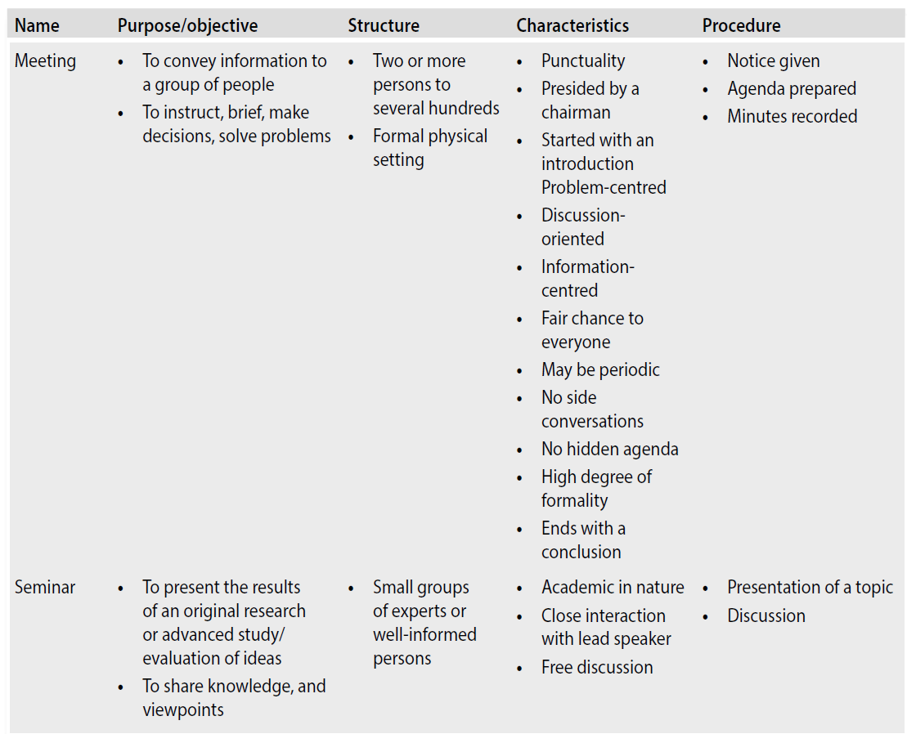

Slide 5
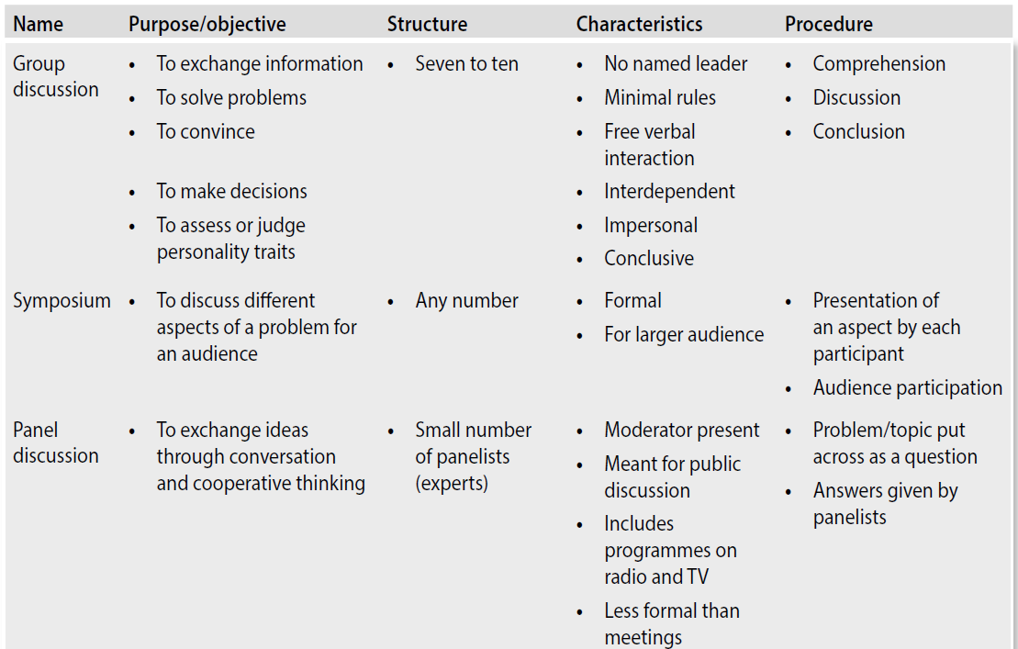

Slide 6
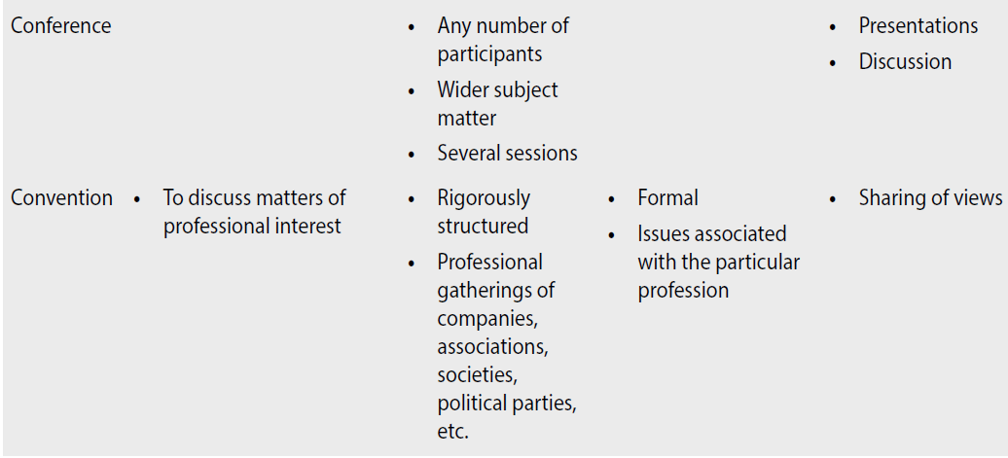

Slide 7

Group Discussion
Definition
Traits
Group behavior
Approach
Dos
Don’ts

Slide 8
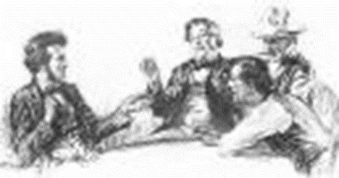
Definition
Communication (small no. of people)
Face-to-face
Free oral interaction
Exchange information
Make decisions

Slide 9

Individual Traits
Ideas (originality)
Articulation (clarity)
Listening
Body Language
Initiative

Slide 10

Group Behaviour
Participation
Leadership
Timesharing & orderly conduct
involving everyone
respecting others’ viewpoints
cooperation

Slide 11
GROUP DISCUSSIONS
for decision-making and problemsolving
used widely as a personality test
The Indian defence forces were the first to tap the potential of GDs

Slide 12
GROUP DISCUSSIONS
Speaking in Group Discussions
Seize the first opportunity to speak if you have a good understanding of the topic of discussion.
Listen patiently to others and then react to their viewpoints.
Speak clearly and audibly so that everyone hears and understands.
Be concise in your expressions. Do not repeat ideas just for the sake of speaking something.
Ask for clarification, if necessary.

Slide 13
GROUP DISCUSSIONS
Speaking in Group Discussions
Facilitate contribution from others.
Use statistics and examples to justify a view point
Avoid talking to only one or two persons in the group.
Assume an impersonal tone. Treat all members as fellow participants; none in the group is either a friend or a foe.
Be assertive without being aggressive; be humble without being submissive
Raise your voice (just enough to be heard) and speak out a strong point in case of a fishmarket-like situation in a GD.
Conclude objectively by briefly presenting the important points of the discussion and any decisions taken

Slide 14
GROUP DISCUSSIONS
Discussing Problems and Solutions
identifying the problem can sometimes be a little difficult.
The problem can be related to a personal, social, physical, or mental aspect, or it might be organizational—technical, managerial, or business related.
Problems must be discussed in detail
Once the problem is identified, get into the discussion about finding a solution.
Discuss elaborately the factors of the system.
there may be the problem of multiple solutions; Choosing the optimal one is essential
Discuss the pros and cons of the various solutions and take inputs from each member.

Slide 15
GROUP DISCUSSIONS
Creating a Cordial and Cooperative Atmosphere
Listen to others’ viewpoints with an open mind and interest.
Respect others’ ideas and try to understand the speaker’s perspective.
Develop mutual trust among each other.
Avoid being too formal with others
Adopt a friendly attitude so that others put forth their ideas freely.

Slide 16
GROUP DISCUSSIONS
Creating a Cordial and Cooperative Atmosphere
Use body language effectively to convey interest and sincerity in the discussion.
Avoid being friendly with only one or two participants in the group.
Be objective and unbiased in the discussion.
Allow others to speak.
Recognize significant contributions by others and appreciate them.

Slide 17
GROUP DISCUSSIONS
Using Persuasive Strategies
Do your homework and be knowledgeable about the topic of discussion.
• Show maturity while reacting to others (by exhibiting appropriate body language and a
firm tone of voice; by not interrupting somebody abruptly).
• Listen carefully and then react.
• Always use evidence (statistics/examples/testimonies) to justify your views.

Slide 18
GROUP DISCUSSIONS
Using Persuasive Strategies
Establish mutual respect.
Win the confidence of others.
Be considerate. We may have a strong view on some issue. However, if others give evidences against these views, be willing to listen.
Always be friendly and respectful during GDs.

Slide 19
GROUP DISCUSSIONS
Being Polite and Firm

Slide 20
GROUP DISCUSSIONS
Turn-taking Strategies
Taking a turn Being ready to speak when one finishes is taking one’s turn.
Holding the turn
There may be members in a group who do not wish to give turns to others to speak.
Yielding the turn
When we give cues to indicate that we are concluding our remarks and others can take up the discussion further, we are yielding the turn.

Slide 21
Effective Intervention
excuse me, sorry to interrupt, may I say something, can I add something, etc
Reaching a Decision
Most of the GDs end with a decision—either final or interim
There are two main categories of GDs
organizational GDs and
GDs as a part of a selection process.

Slide 22
GD AS PART OF SELECTION PROCESS
A group discussion conducted for the selection of candidates for a job or for admission is a well-formulated tool for judging
the personality of candidates, their communication skills, knowledge, and their ability to work as a team

Slide 23
Characteristics
candidates are given a topic or case for discussion
Normally groups of 8–10 candidates are formed into a leaderless group
given a specific situation to analyse and discuss within a given time limit of about 30 minutes
Depending upon the infrastructure at the venue, the group is asked to sit in a circular, rectangular, or U-shaped arrangement
Panel comprises the technical executives and human resources executives of the company
The rules of the GD—time limit, panel’s expectations, etc.—are explained

Slide 24
Evaluation and Analysis
The four components generally evaluated and analysed in a GD are as follows:
Knowledge
Group behaviour (team spirit)
Communication skills
Leadership skills

Slide 25
Evaluation and Analysis
Knowledge
The depth and range of knowledge as well as analytical and organizational abilities of the candidate are judged
The originality of ideas, knowledge and initiative, and approach to the topic or case contribute to one’s success in the GD.

Slide 26
Evaluation and Analysis
Communication skills
Active listening
Clarity of thought and expression
Tone: Quality or character of the voice expressing a particular feeling or mood
• Voice: Correct projection of voice
• Articulation: Act of speaking or expressing an idea in words
• Fluency: Speaking or writing in an easy, flowing style
• Modulation: Variations in tone or volume of voice
• Good delivery: Ideas expressed fluently in the right voice, right tone, and right articulation

Slide 27
Evaluation and Analysis
Communication skills
Appropriate language
The language used should be accurate and free of grammatical errors
Do not use long, winding sentences
Do not use jargon
Appropriateness of body language

Slide 28
Evaluation and Analysis
Group behaviour (team spirit)
ability to interact with other members of the group on brief acquaintance.
Emotional maturity and balance promotes good interpersonal relationships.
You are expected to be more people-centric and less egocentric
coordination and cooperation among the various members
The successful candidate is the one who shows an active interest in the proceedings by being involved throughout the GD
ability to analyse a problem and persuade others to see it from multiple perspectives without offending group members is an important trait of a good communicator
appreciating others’ points of view
able to effectively communicate our own view without obviously contradicting others’ opinions.
Try to build up an argument from the point where the last speaker left

Slide 29
Evaluation and Analysis
Leadership skills
a leader usually emerges as the discussion proceeds.
The candidate who possesses both functional and coordinating abilities will emerge as the leader.
Functional ability involves knowledge, mental and physical energy, emotional stability, objectivity, communication skill, integrity, and emotional intelligence.
Coordinating ability involves traits such as group adaptability and group motivation.

Slide 30
Evaluation and Analysis
Leadership skills
Authoritative
They attempt to impose their will or values on the other group members or try to push them into supporting their decisions.
amiable.
They consistently try to avoid conflict or unpleasant feelings from being expressed and always try to maintain a peaceful environment during the GD.
Democratic
Such leaders try to include everyone in the discussion and express their feelings and opinions openly and directly without judging others. When there is a conflict, they try to deal with it as a problem-solving exercise.
Obviously, the selection panel would prefer the democratic leader.

Slide 31

Dos
Sit comfortably
Listen to topic
Organize ideas
Speak at the earliest
Identify supporters opponents
Allow supporter to augment
Keep track of time
Share time fairly
Maintain eye contact
Take notes
Aim for conclusion not consensus

Slide 32

Don’ts
Be in a hurry
Be silent
Dominate vocally/physically
Assume role of chairman
Introduce topic
Take extreme stance
Look at faculty
Shut down inert participants
Move excessively
Throw all ideas at one shot
Speak fast
Digress
Indulge in ill conversation
Pay attention to bull dozers
Use slang
Get emotional

Slide 33
Any Questions

